Slide 1

Source: Campbell Junior High School
Notes:
Image credit: Campbell Junior High School - https://teach.clarkschools.net/Middle/Campbell/index.php/rdc-literacy-focus/

Slide 2

Building Literacy
Data Science and K-3 Eduction
by Sean Davern
ALLPPT.com _ Free PowerPoint Templates

Slide 3
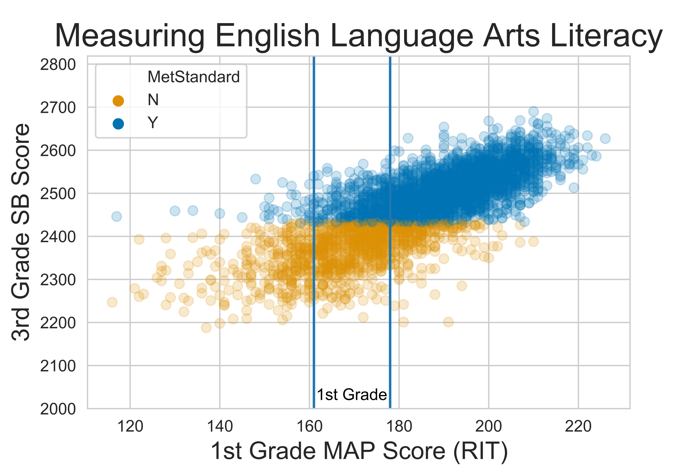
The Challenge(s)
Notes:
MAP score units: RIT (Rasch Unit)
Smarter Balance score are unitless. 3rd Grade Levels:
1: < 2381
2: 2381-2431
3: 2432-2489
4: > 2489

Slide 4

Serving K-3 Elementary Kids

Slide 5
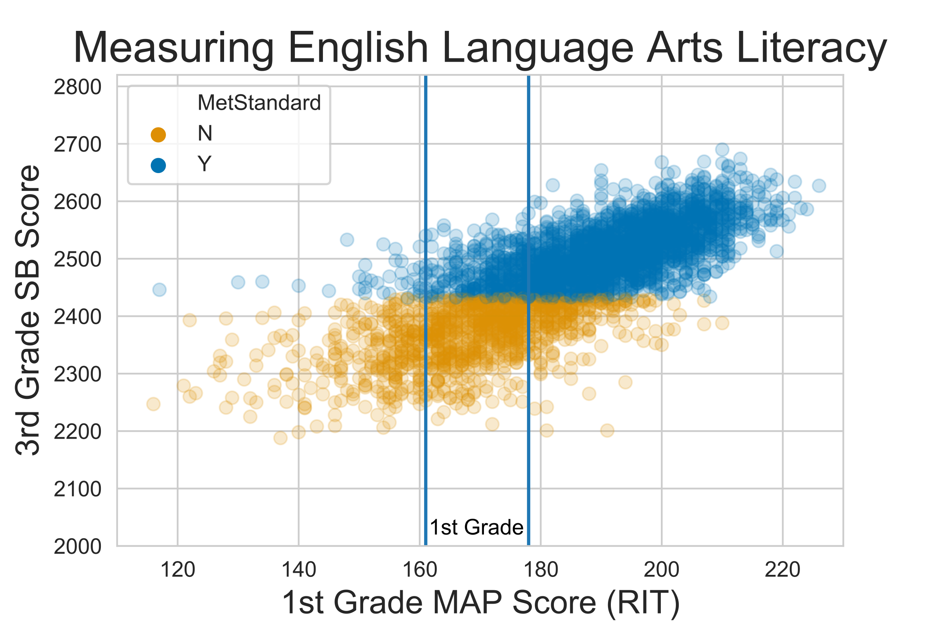
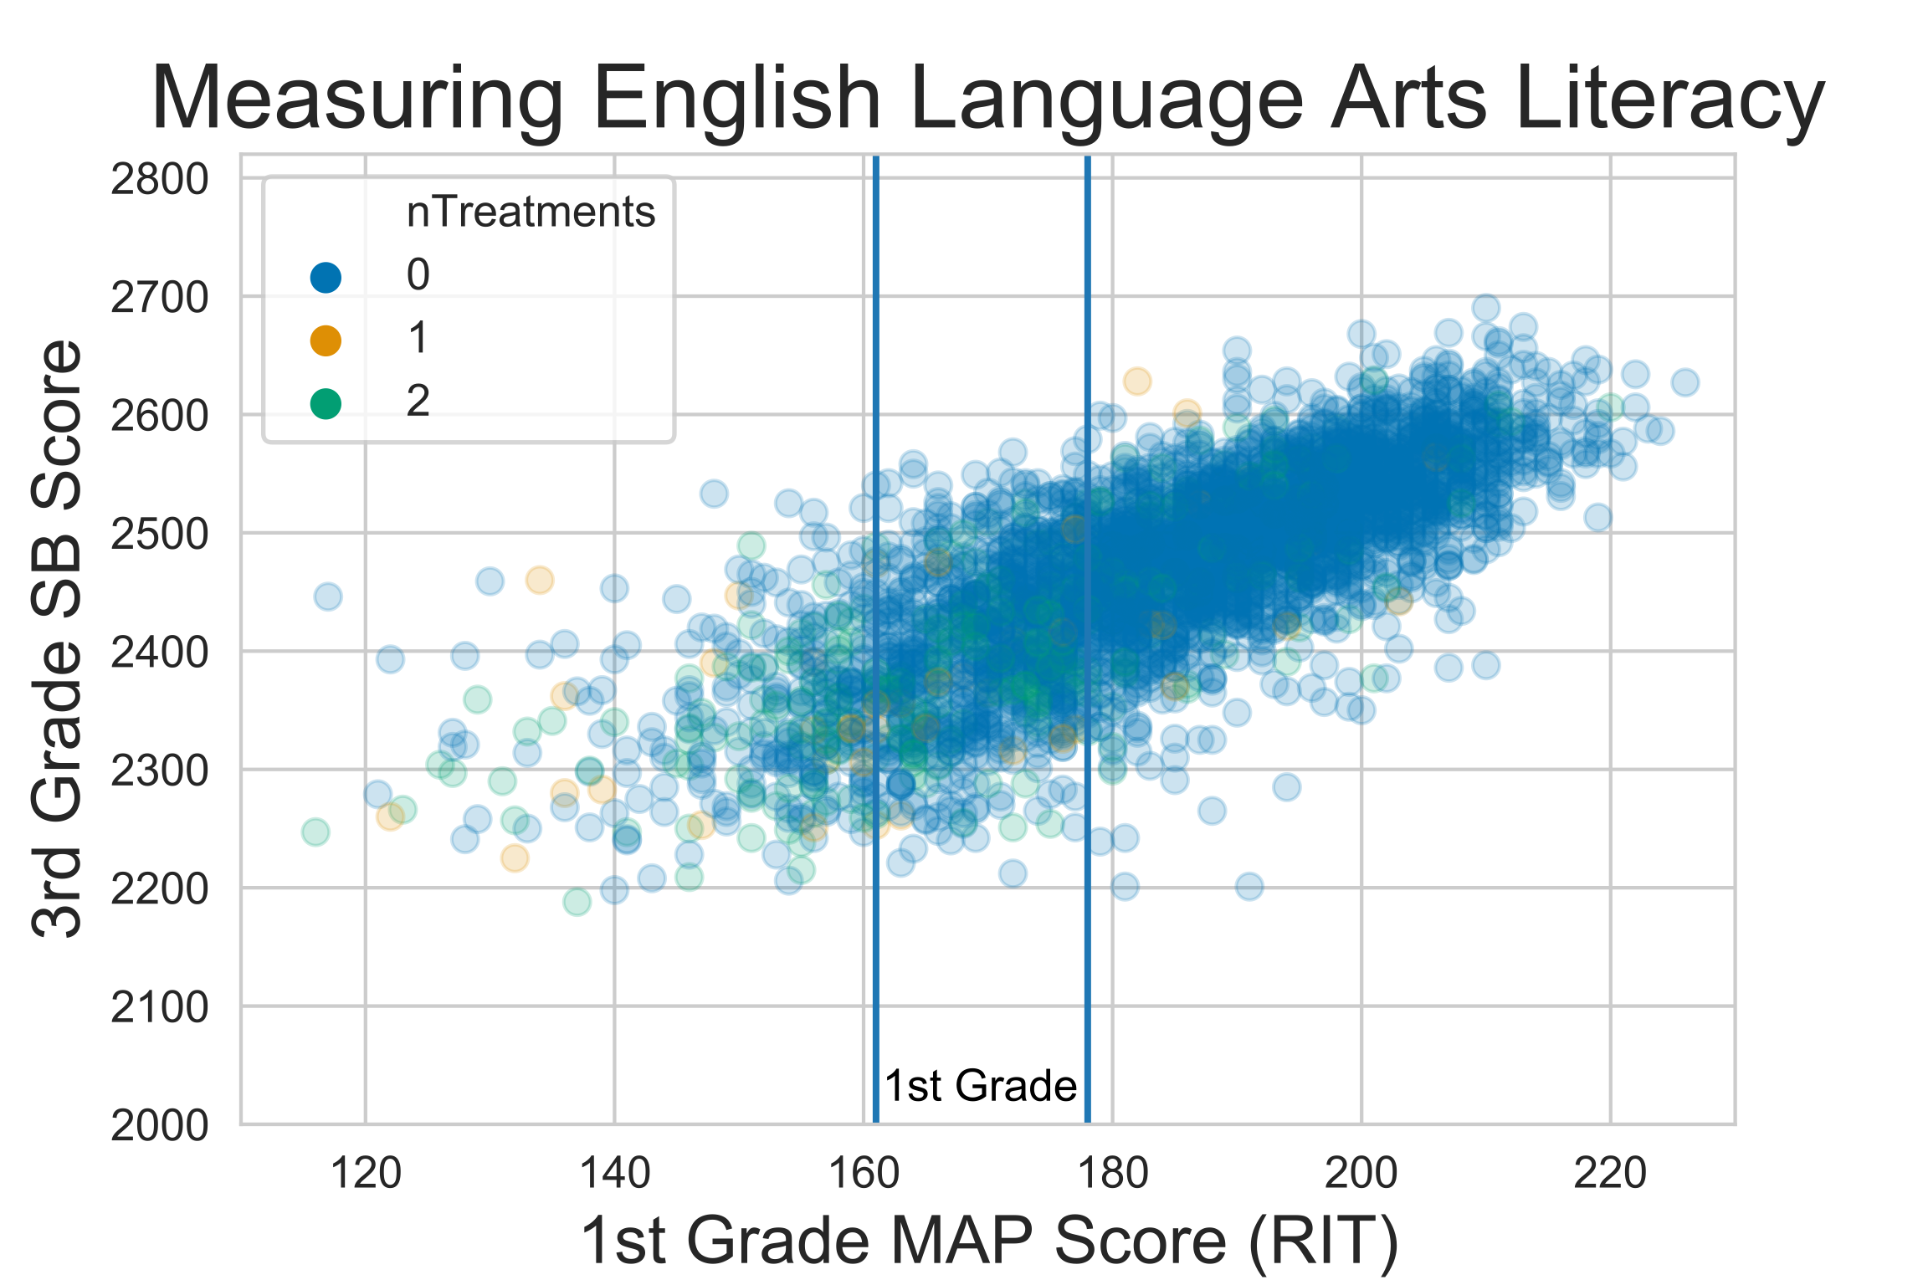
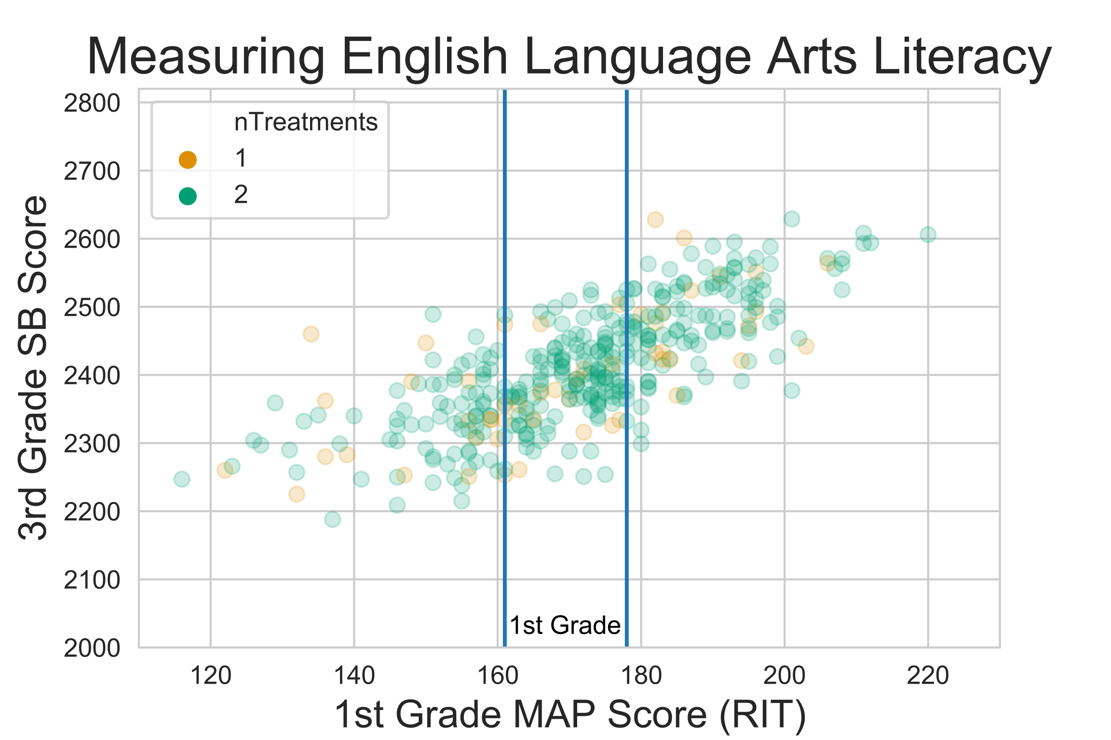
The Challenge(s)
Notes:
RIT (Rasch Unit)

Slide 6
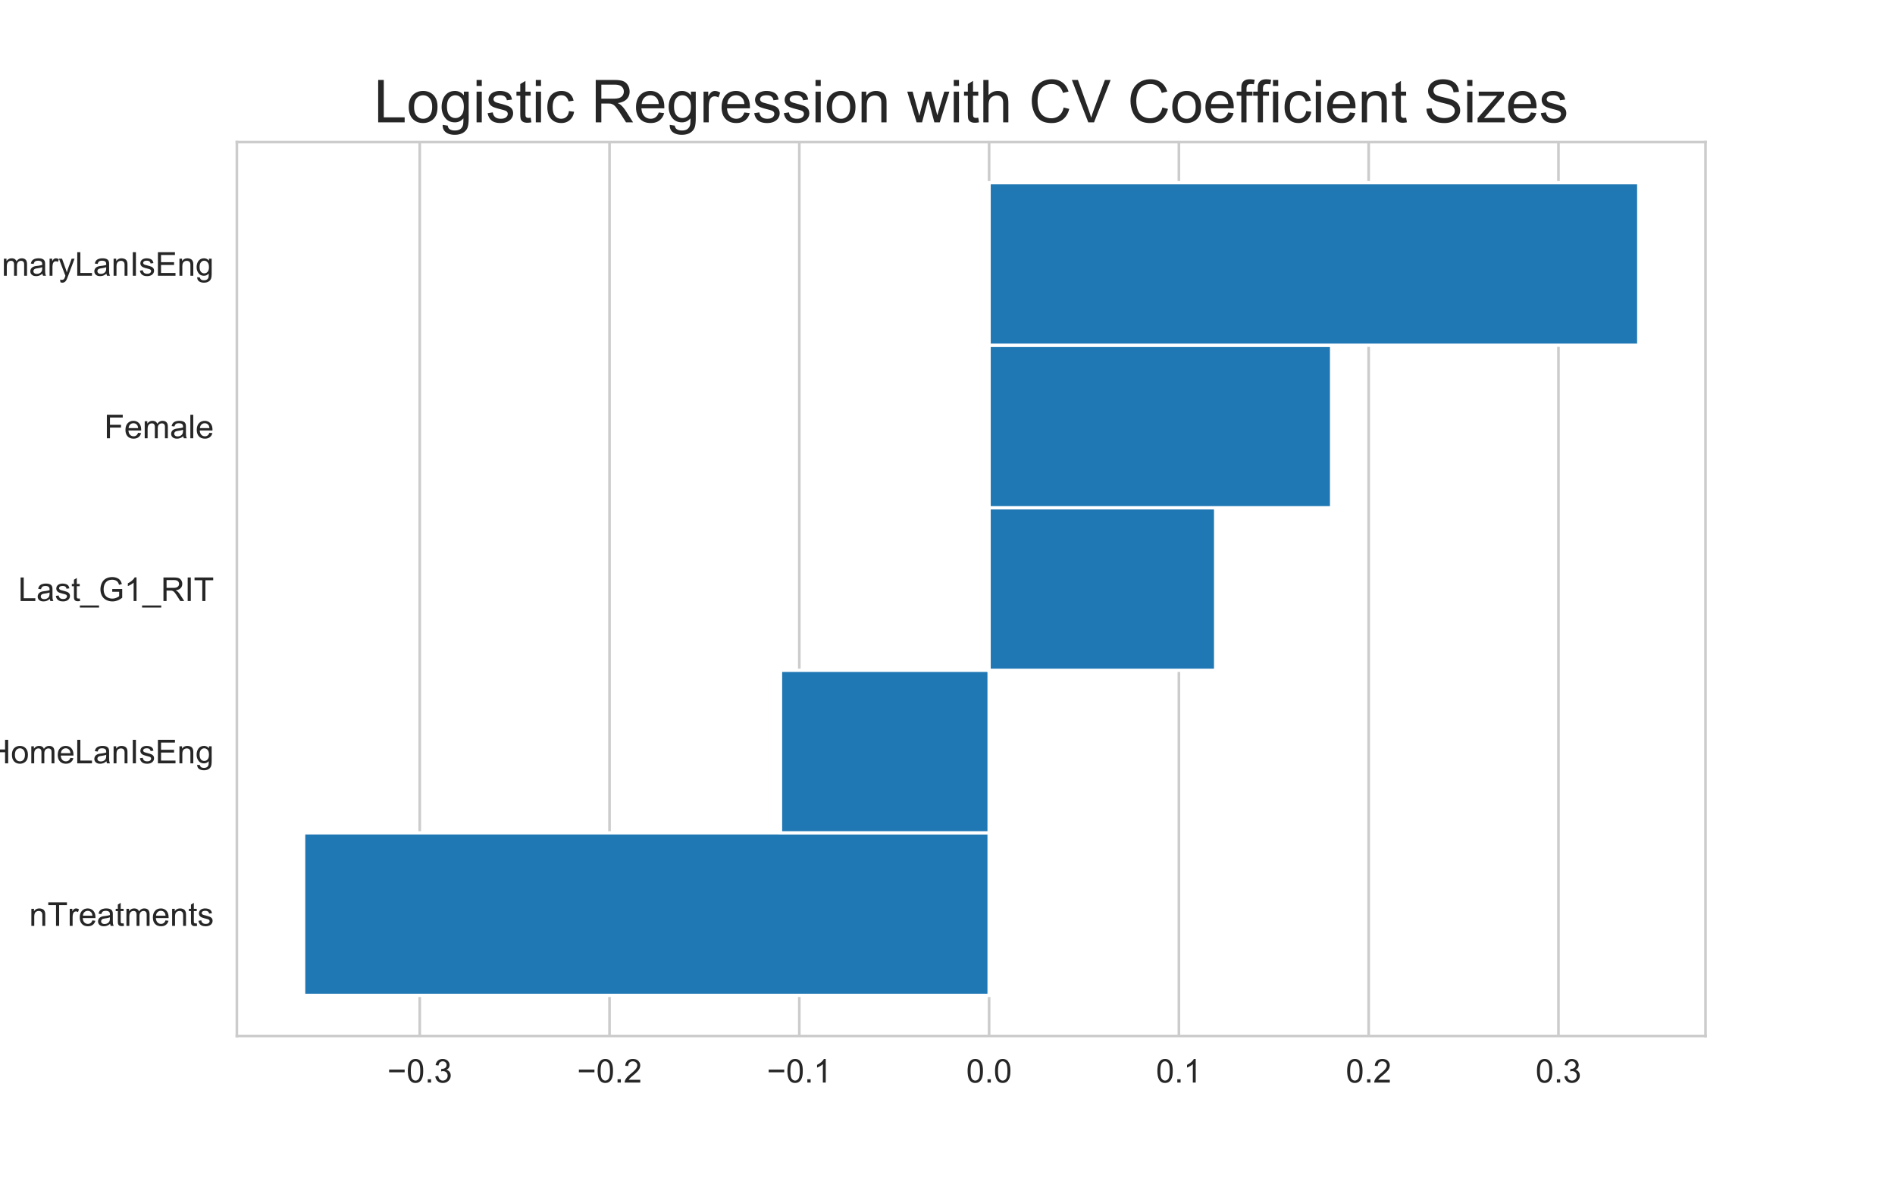
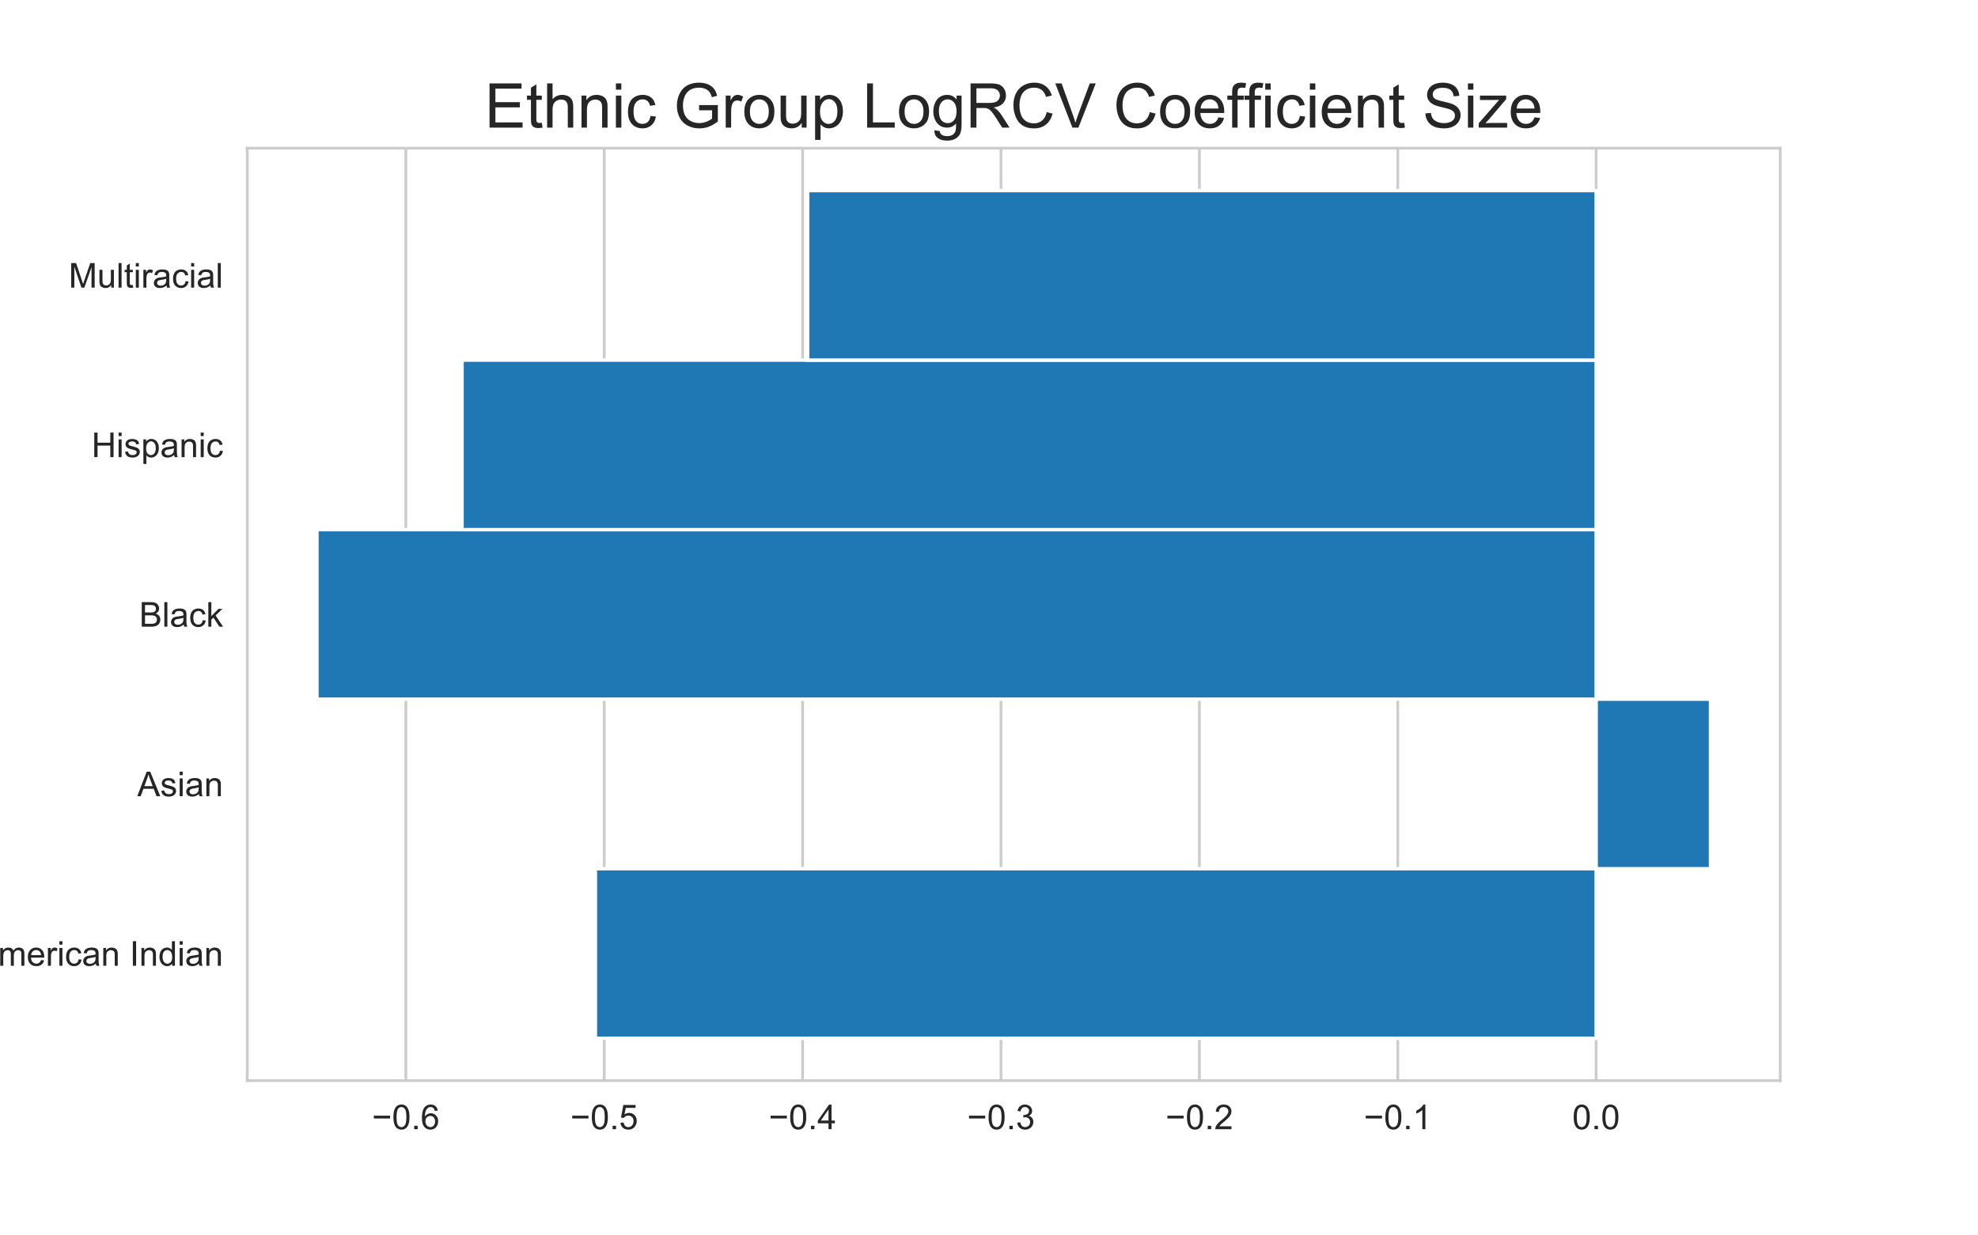
Model Results
 | precision | recall | f1-score | support
N | 0.76 | 0.69 | 0.72 | 219
Y | 0.87 | 0.90 | 0.88 | 492
accuracy |  |  | 0.84 | 711
macro avg | 0.81 | 0.80 | 0.80 | 711
weighted avg | 0.83 | 0.84 | 0.83 | 711
Notes:
precision is the ability of the classifier not to label as positive a sample that is negative
recall is the ability of the classifier to find all the positive samples
F-measure (F1 measures) can be interpreted as a weighted harmonic mean of the precision and recall

Slide 7
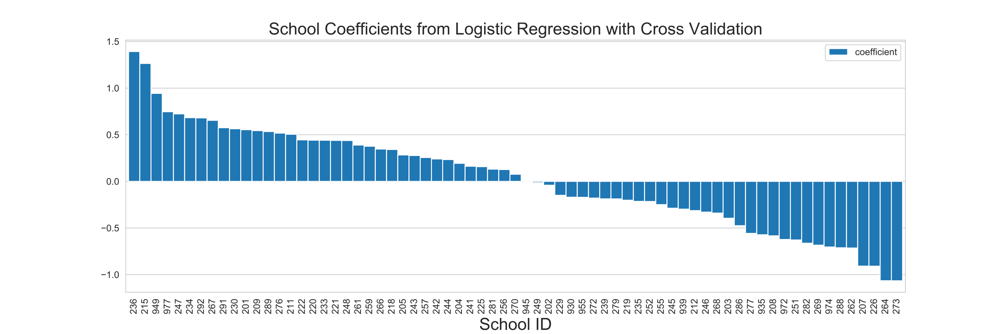
Model Results

Slide 8
Future Work
Page Ahead consultation and
Model expansion work

Slide 9
Appendix

Slide 10
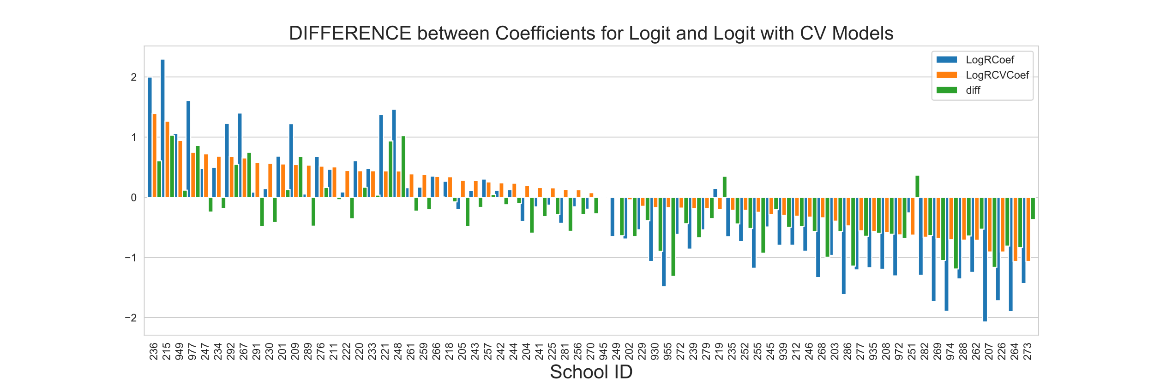
Model Results

Slide 11
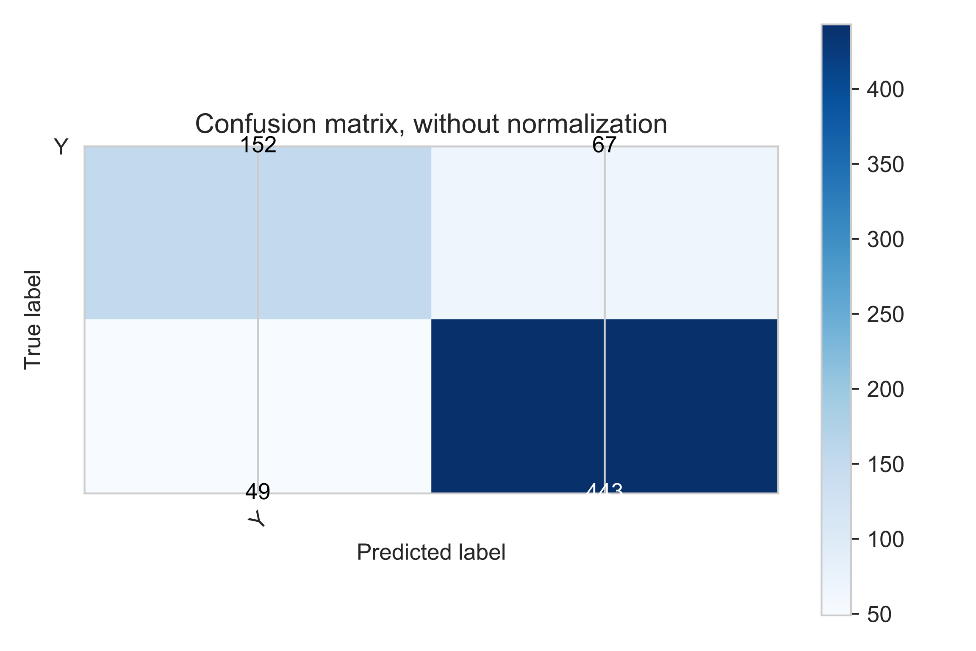
Confusion Matrix

Slide 12
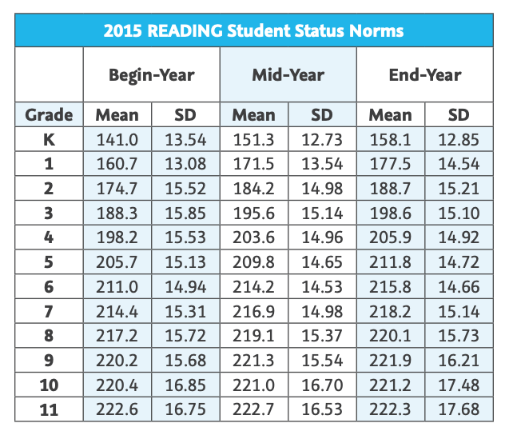
Reading Score Norms
Notes:
Source: https://www.kusd.edu/lance/houses/documents/2015-MAP-Normative-Data-AUG15.pdf

